Slide 1



Head Start Machine Learning
Session 3:
Machine Learning with
Amos Tan Li Sheng
Year 2 CS(AI)
Hong Jia Herng
Year 2 CS(IS)

Slide 2

Attendance
> Select Tab “Head Start Machine Learning”
> Mark your attendance by inserting “1”
> Do it within this 2 hours

Slide 3
What are we going to learn?
Solve a ML problem using Scikit-Learn
Data exploration
Data preparation
Hyperparameter search using k-fold cross-validation
Drop your question in the chat box if you don’t understand anything!

Slide 4
6 common steps when doing a ML project
Frame the problem
Get the data
Explore the data
Prepare the data for ML algorithms
Select a model and train it
Improve your model

Slide 5
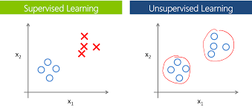

Frame the problem
Some questions to ask yourself ...
Is it a supervised or unsupervised learning task?
Is it a classification or regression task?
What performance measure to use for this problem?
Regression : MSE, RMSE, MAE, etc.
Classification : Accuracy, Precision, Recall, F1 score, etc.

Slide 6
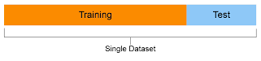
2) Get the data
After getting the data, you should do this!
Split dataset into training set and test set
Put test set aside and never look at it (typically below 40% of the whole dataset)
We want to work solely with our training set to prevent us from overfitting onto the entire dataset
Test set enables you to obtain an estimate for the generalization error that your model will have when deploying in production

Slide 7
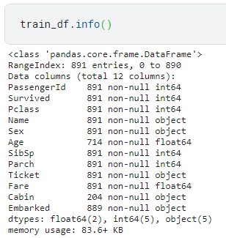
3) Explore the data
Understand your data
Study each attribute and its characteristics
Which features contain null values?
Age, Cabin, Embarked
Which features are categorical?
Survived (Target), Sex, Ticket, Cabin, Embarked, Pclass (Ordinal)
Which features are numerical?
Age, Fare, SibSp (Discrete), Parch (Discrete)
And more...

Slide 8
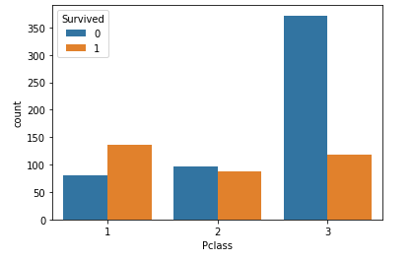
3) Explore the data
Understand your data
Visualize the data
Pclass: socio-economic status
1 → upper
2 → middle
3 → lower
From this visualization, we can infer that upper class people has higher surviving rate
Notes:
number of death increases when Pclass increases

Slide 9
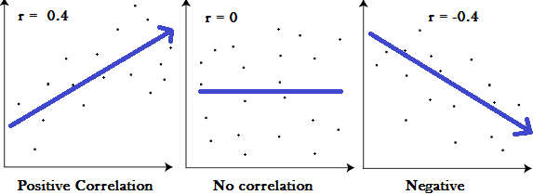
3) Explore the data
Understand your data
Determine correlation of each numerical feature to target
Pearson’s r
ranges from -1 to 1
near to 1, strong positive correlation
near to -1, strong negative correlation
near to 0, no linear correlation
cons:
only measure “linear” correlation (if 𝔁 ↑, then 𝐲 ↑ or ↓), may miss nonlinear correlation (when 𝔁 close to 0, then 𝐲 ↑ or ↓)
Notes:
Pclass has -ve corr to Survived, Pclass decreases, Survived increases (refer previous slides)

Slide 10
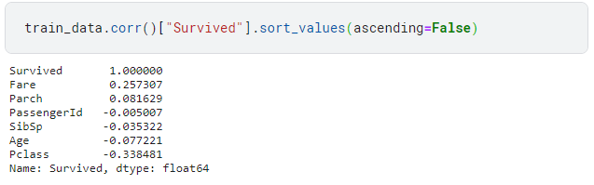
3) Explore the data
Understand your data
Notes:
Pclass has -ve corr to Survived, Pclass decreases, Survived increases (refer previous slides)

Slide 11
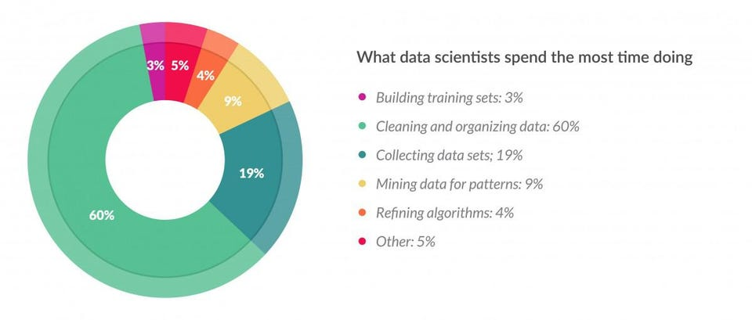
Data scientists spend 60% of their time on cleaning and organizing data.
https://www.forbes.com/sites/gilpress/2016/03/23/data-preparation-most-time-consuming-least-enjoyable-data-science-task-survey-says/?sh=5a9a94ed6f63

Slide 12

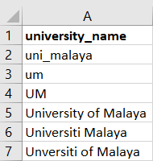
4) Data preparation
Before feeding into ML algorithm
Data cleaning
Might have incomplete data / anomalies that results from human error
Fix or remove outliers
Fill in missing values (zero, mean, median, or drop the entire row/column)
Notes:
Add this

Slide 13
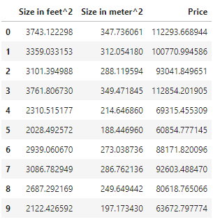
4) Data preparation
Before feeding into ML algorithm
Feature selection
Drop the features that provide no useful information for the task (could be based on correlation coefficient)
Remove repeated feature, if any
(repeated columns are said to be linearly dependent with each other)
square meter = 0.09290304 * square feet
Notes:
Features that don’t provide useful information to the task might make the dataset more noisy.
Affect the performance of ML algorithms
Linearly dependent

Slide 14



4) Data preparation
time taken
distance travelled
Before feeding into ML algorithm
Feature engineering
Some attributes might not make much sense on their own
Combining attributes could give more information to the model
speed = distance travelled / time taken

Slide 15

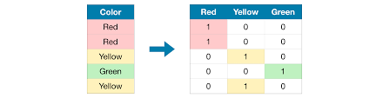
4) Data preparation
Ordinal encoding
Before feeding into ML algorithm
Handling categorical attributes
Most ML algorithms prefer to work with numbers
Need to convert categorical into numerical
2 common methods:
Ordinal encoding
One-hot encoding
One-hot encoding

Slide 16
4) Data preparation
Before feeding into ML algorithm
Ordinal encoding
ML algorithms assume that 2 nearby values are more similar than 2 distant values
Not suitable to use for the categories that have equal existence (red, blue, green)

Slide 17
4) Data preparation
Before feeding into ML algorithm
One-hot encoding
Fix the issue that ordinal encoding produces
But if there’s a large number of categories, 1-hot encoding results in a large number of input features
may slow down training

Slide 18
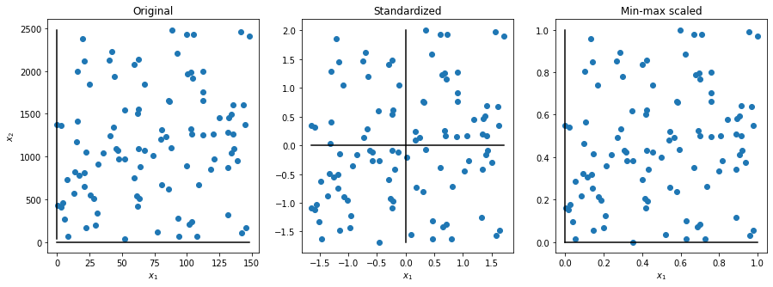
4) Data preparation
Before feeding into ML algorithm
Feature scaling
speed up training time

Slide 19
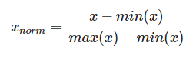
4) Data preparation
Before feeding into ML algorithm
Min-max scaling / Normalization
Scale input features into the range of [0, 1]

Slide 20
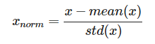
4) Data preparation
Before feeding into ML algorithm
Standardization
Scale input features into standard normally distributed data
No bounding range

Slide 21
5) Select a model and train it
The only part that uses ML algorithms
After the data is well prepared, the rest you need to do is just select a suitable model and train it on the training set
For a supervised learning problem, it is usually either a classification or regression problem
https://scikit-learn.org/stable/

Slide 22
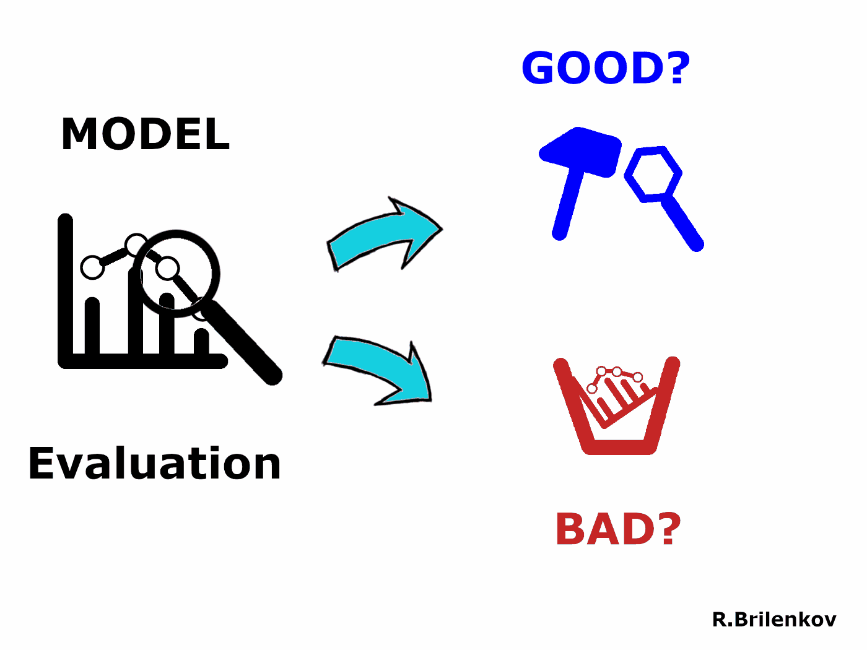
5) Select a model and train it
Evaluate your model
Use the performance measure that you’ve chosen at step 1) to evaluate it
It’s a metric to tell how well your model is performing on predicting the target
You can also use it to compare the performance of different models

Slide 23
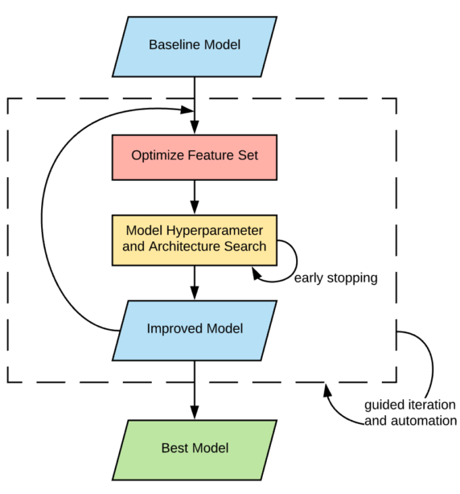
6) Improving your model
What to do to improve the performance?
Try different models
Revisit previous data preparation steps
Hyperparameter tuning

Slide 24
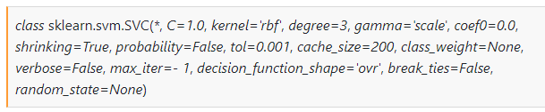
6) Improving your model
What to do to improve the performance?
Hyperparameter tuning
Search for the best set of hyperparameters for the model
2 common ways: Grid search or Randomized search
hyperparameters
...

Slide 25
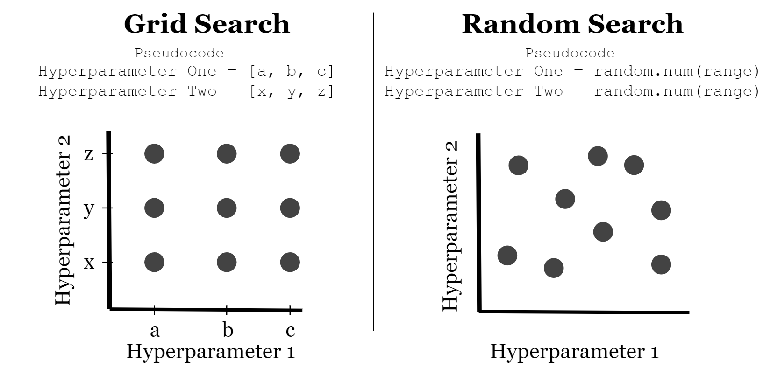
6) Improving your model
What to do to improve the performance?
Hyperparameter tuning

Slide 26
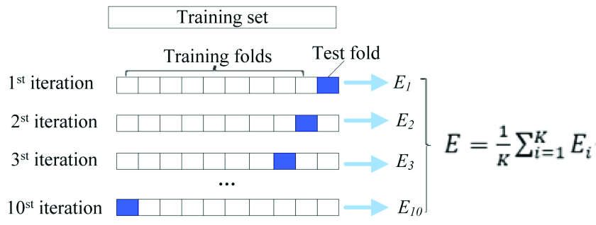
6) Improving your model
What to do to improve the performance?
Search using k-fold cross-validation
Provide the number of folds, k
Randomly split the training set into k folds
Model trains on the k-1 folds and evaluate on the remaining 1 fold for k iterations
Performance measure are averaged over k values

Slide 27
Q&A

Slide 28
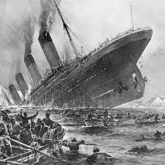
Let’s do the hands-on session now!

Slide 29

Leave us your feedback
https://forms.gle/FGfQTmJxHUtNGzfw6

Slide 30
Group photo!

